Slide 1
SLE Patients B cells repertoire analysis
HC vs SLE IgH in PBMC

Slide 2
AntibodyMap
http://antibodymap.org/
Observed Antibody Space (OAS) Database
Collates >1B redundant antibody sequences from 60 studies
Identified bulk sequenced blood B cells
Healthy Controls
SLE patients

Slide 3


Slide 4
Immcantation Analysis
IMGT High V Quest annotation
Connect to Immcantation Docker
Parse IMGT output
Combine all dataset
Determine clonal threshold with Shazam
Assign clonal group with Change-O

Slide 5
Isotype Analysis

Slide 6
Isotype Analysis

Slide 7
Clonal Diversity

Slide 8
Clonal Diversity

Slide 9
Mutation frequencies analysis

Slide 10
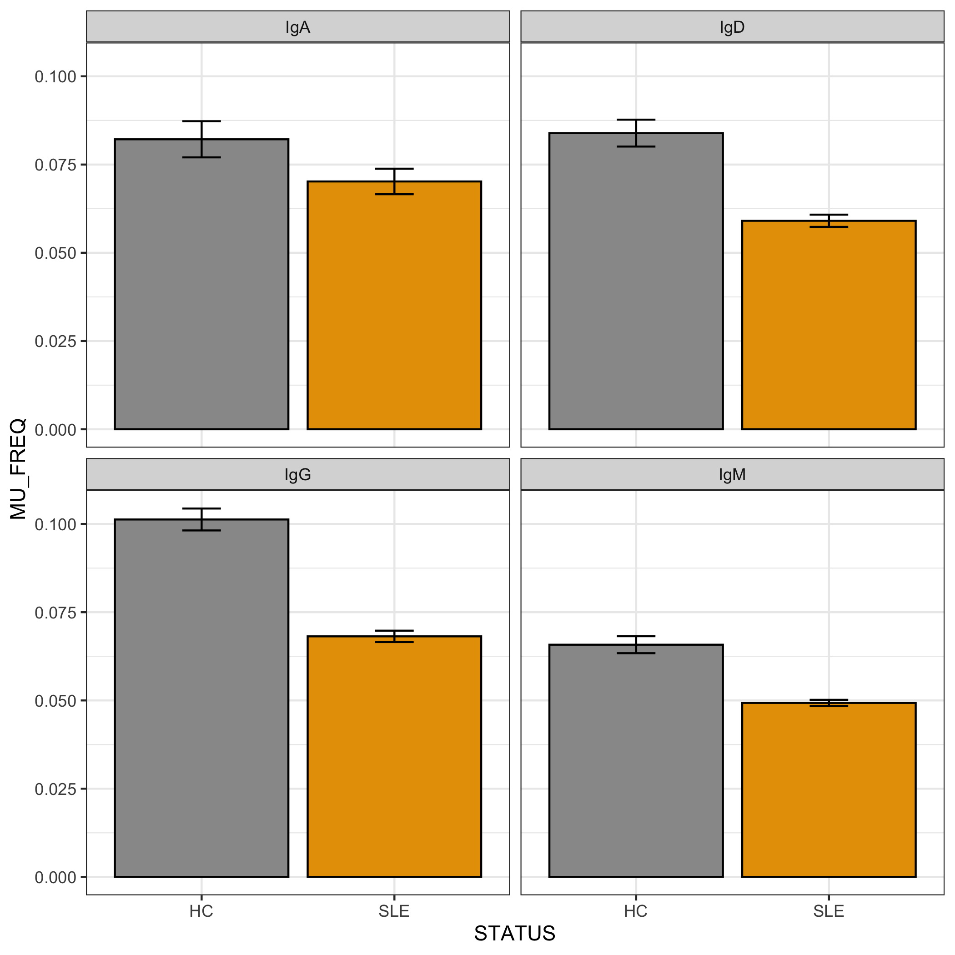
Mutation frequencies analysis

Slide 11
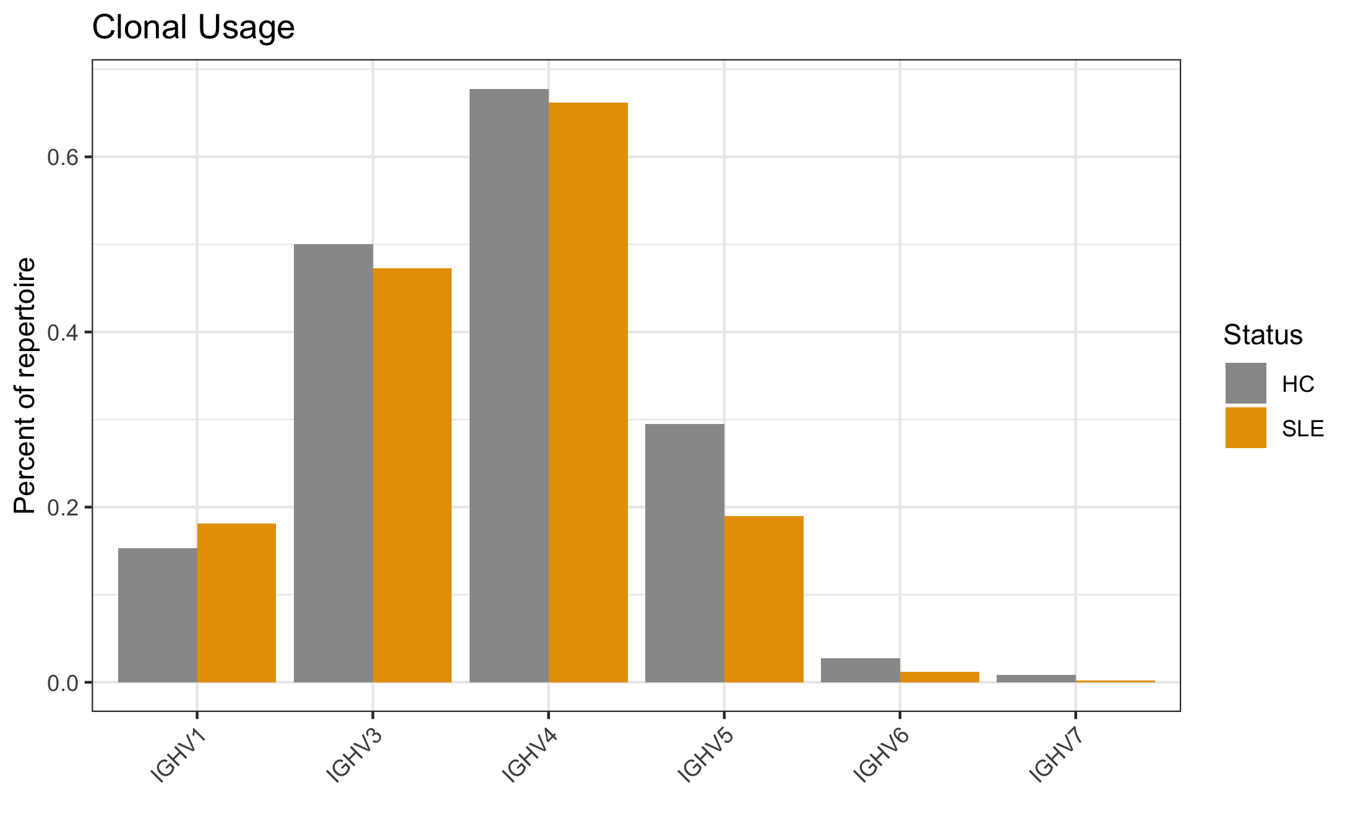
V-genes usage

Slide 12
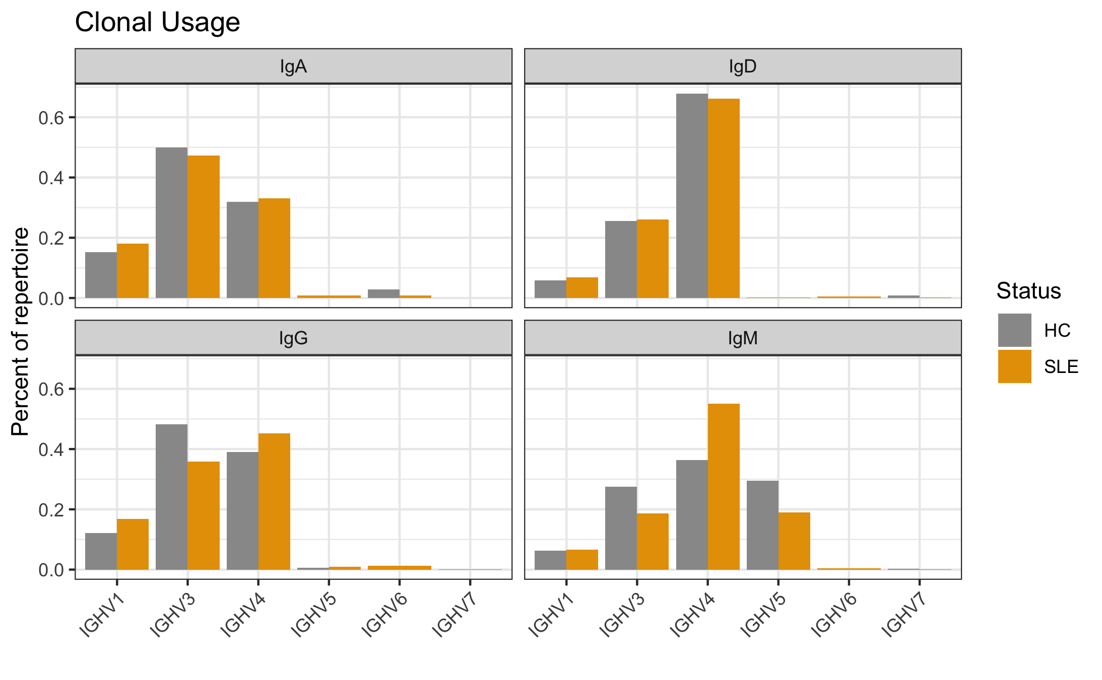
V-genes usage

Slide 13
VH4-34 gene usage

Slide 14
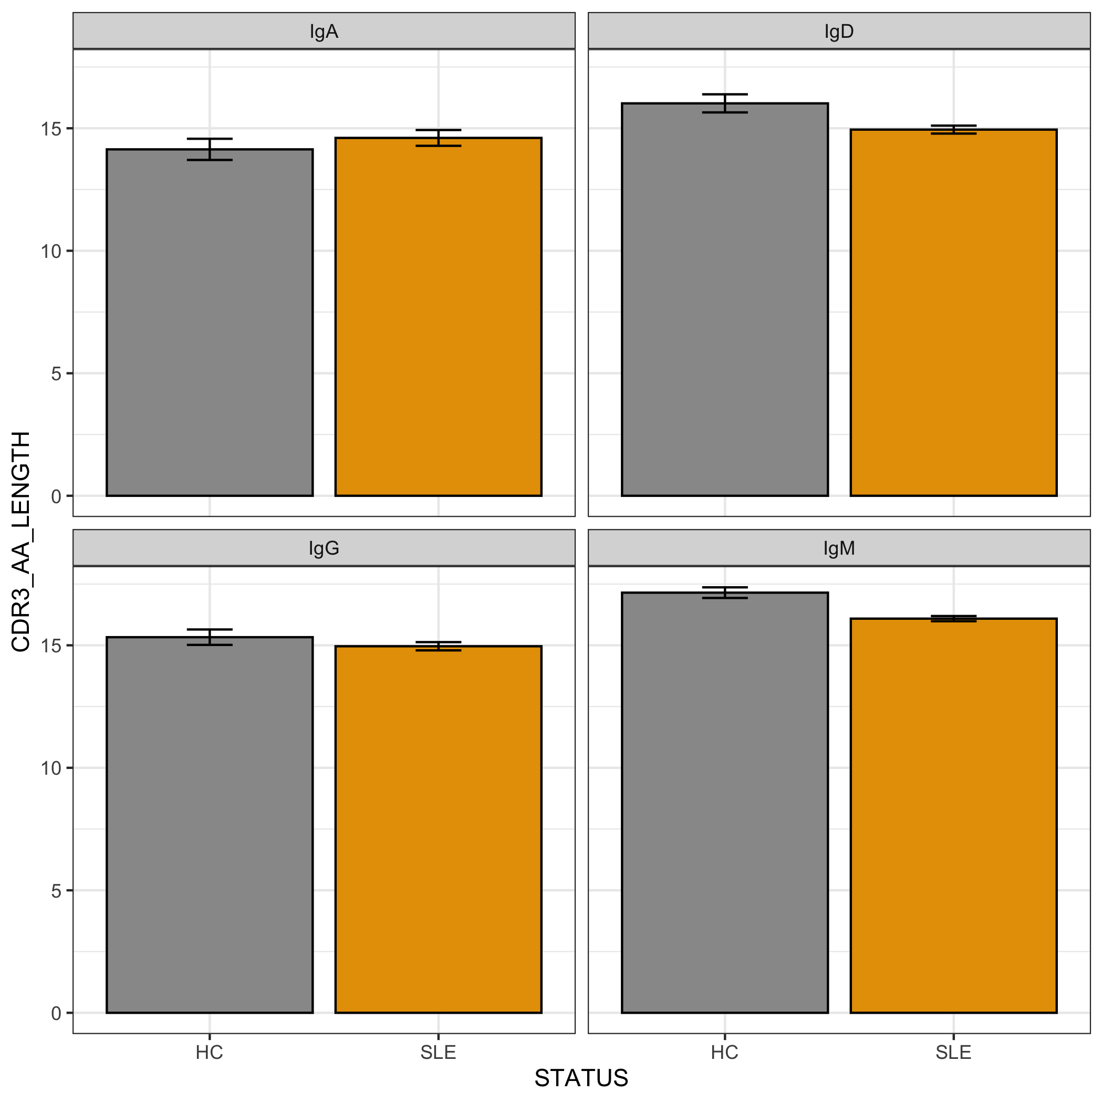
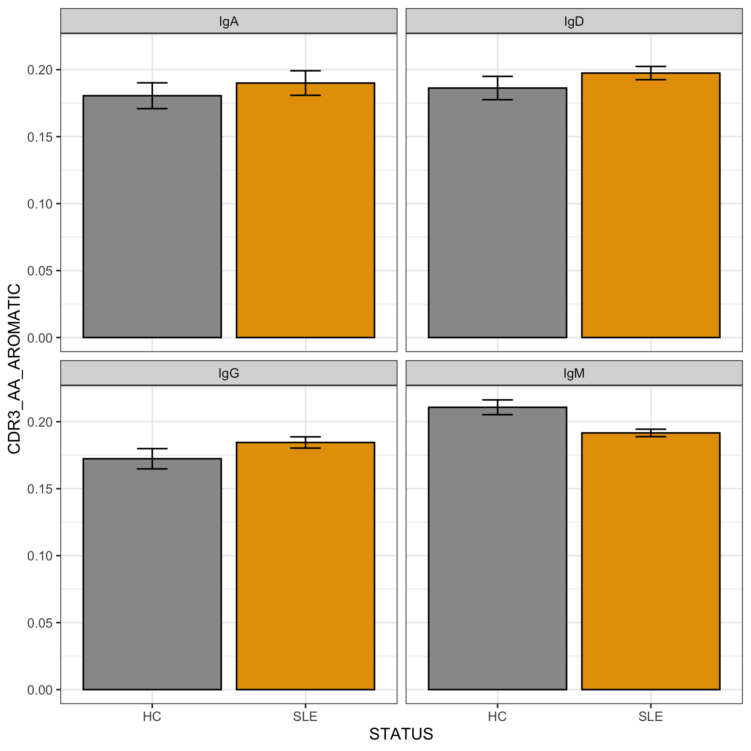
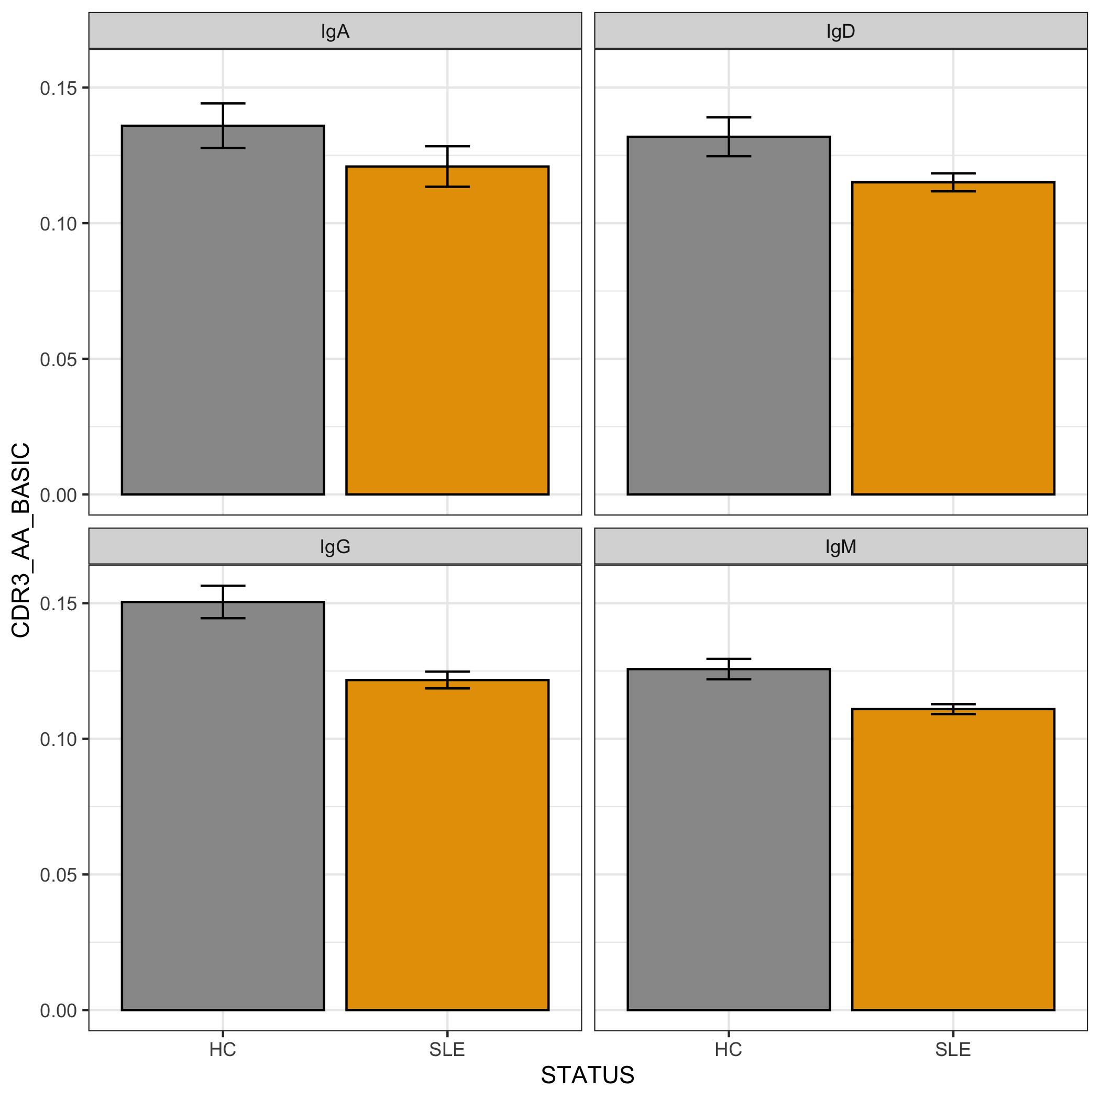
Physicochemical properties analysis

Slide 15
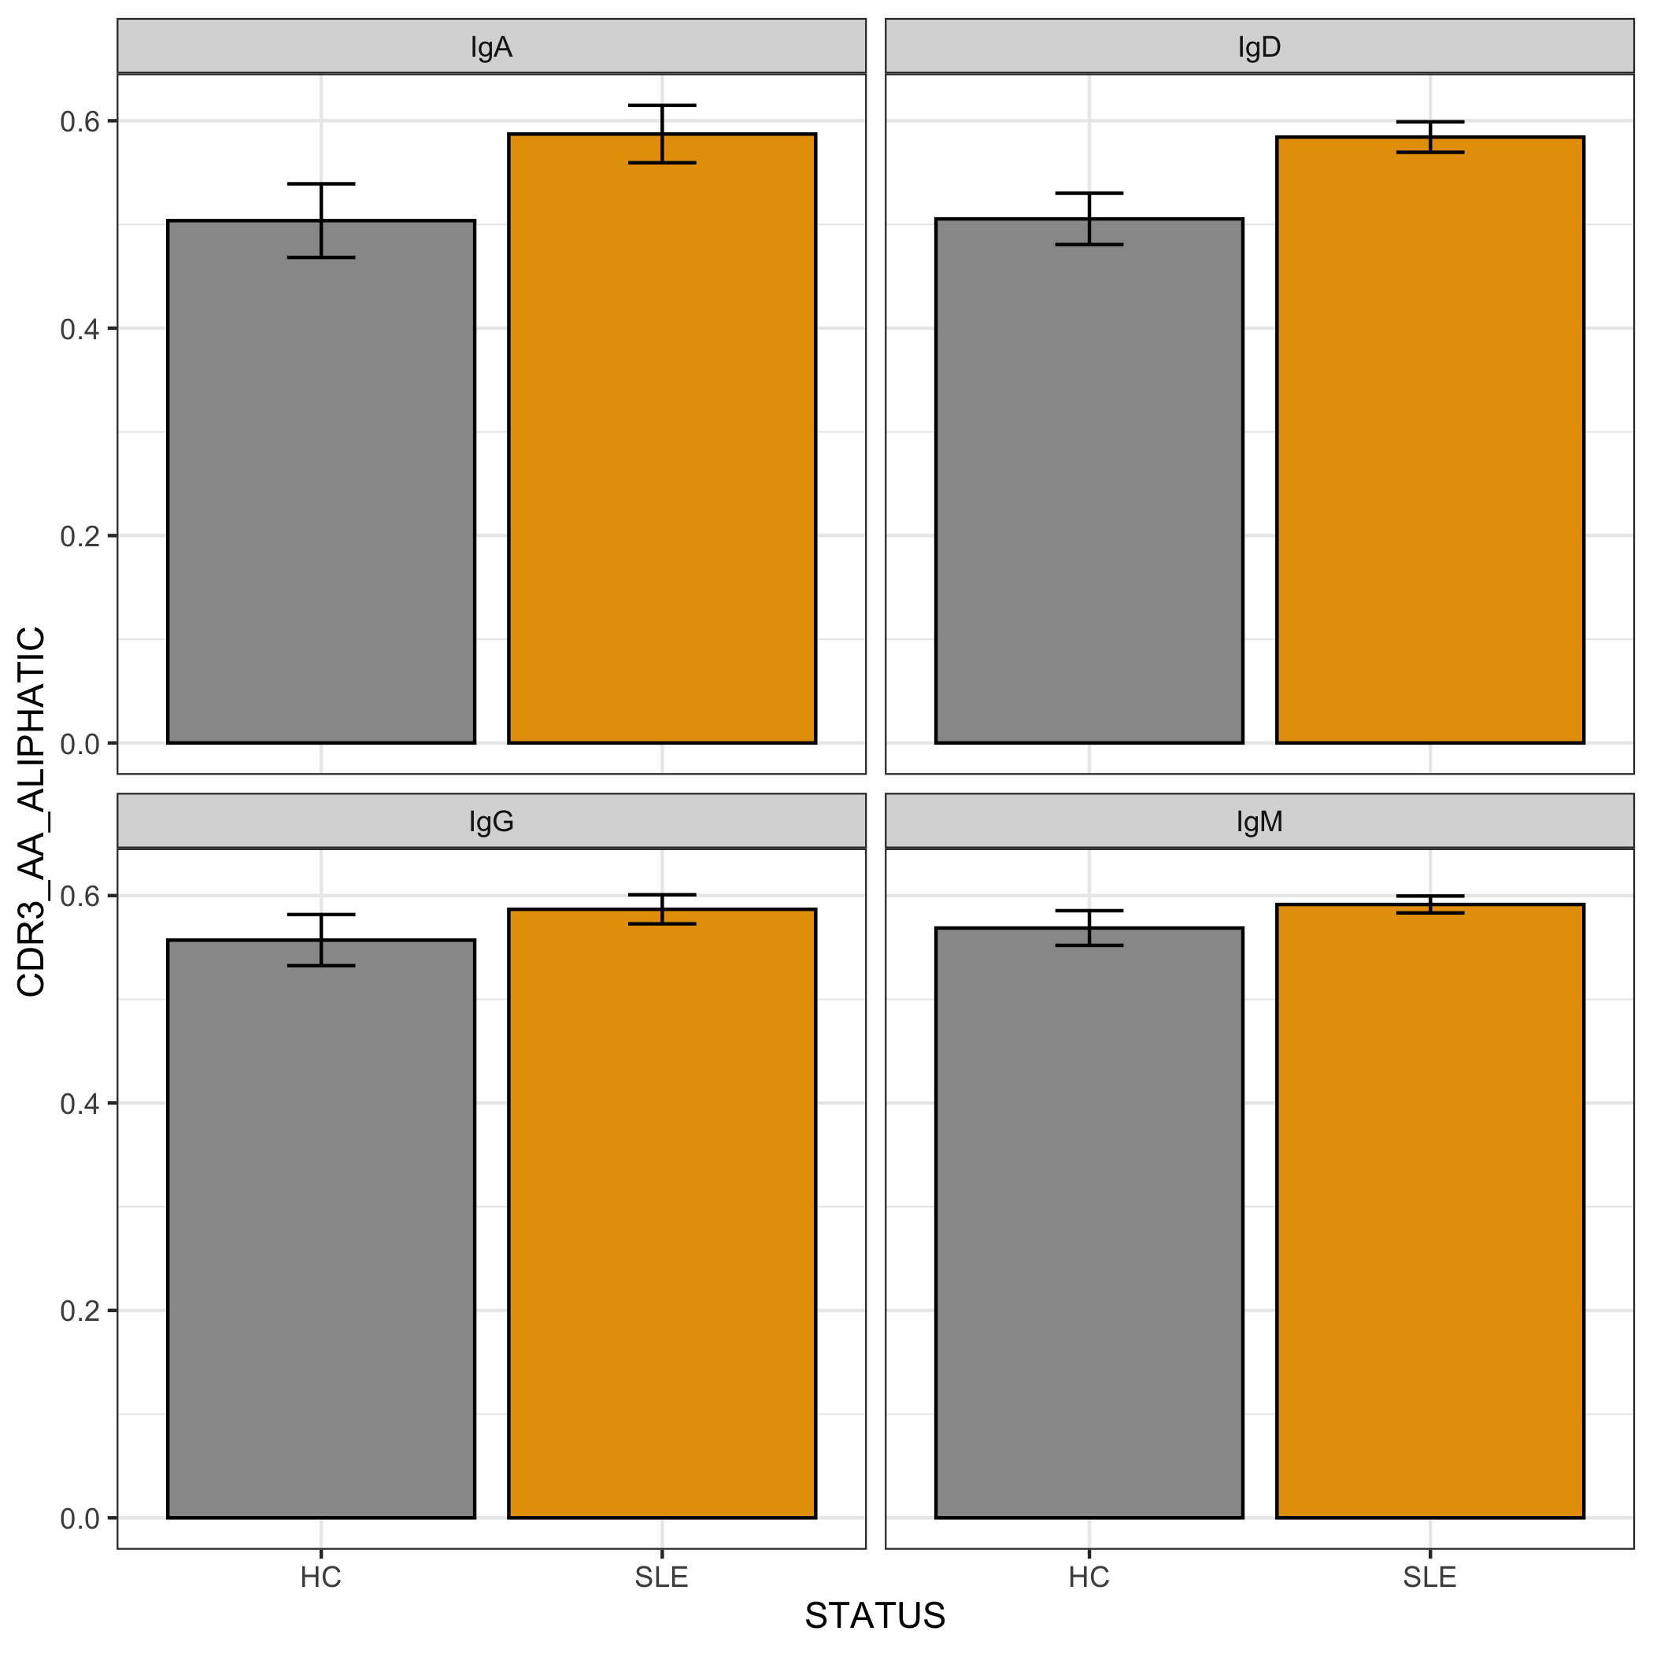
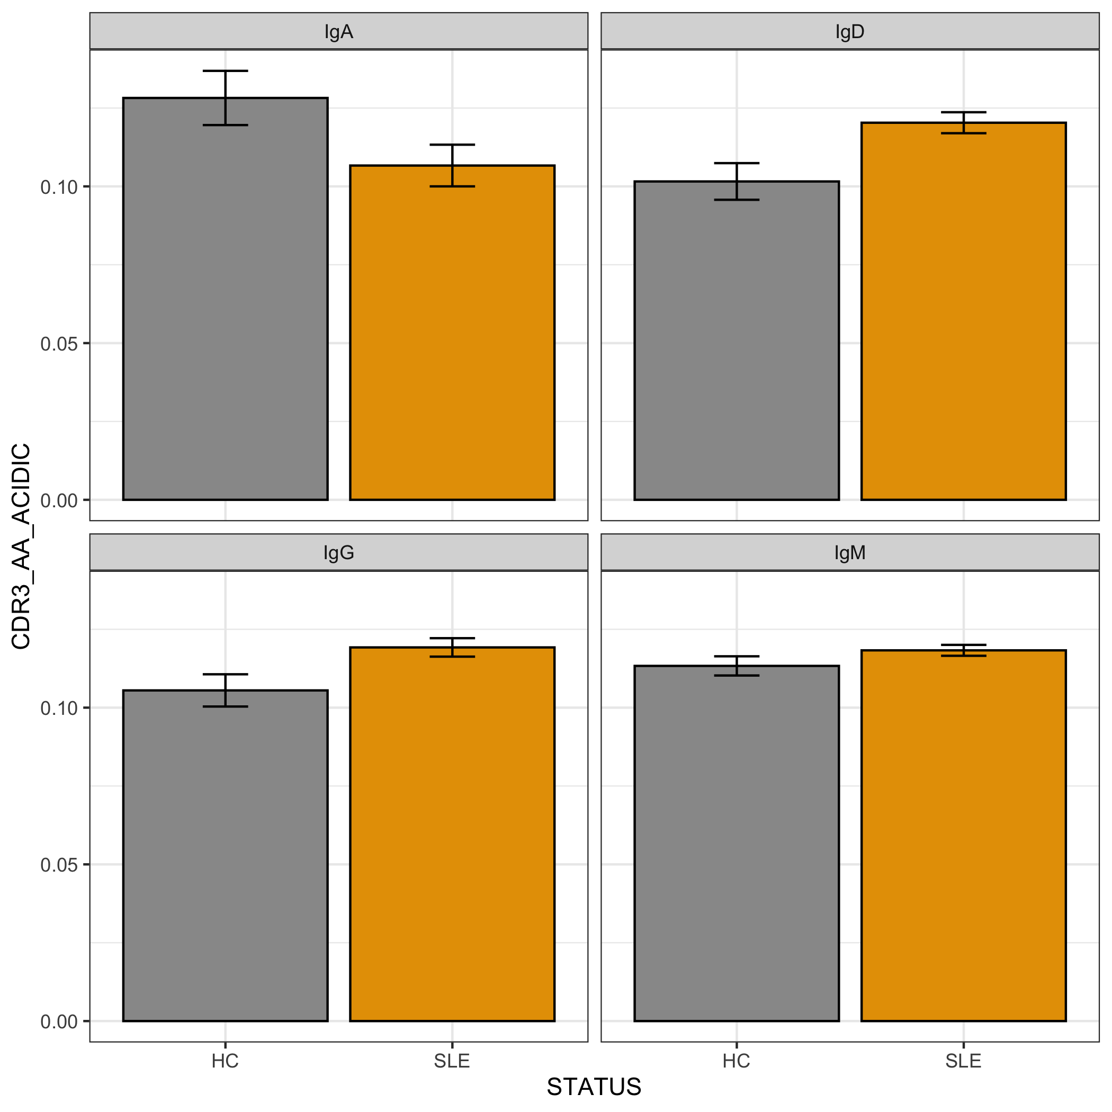
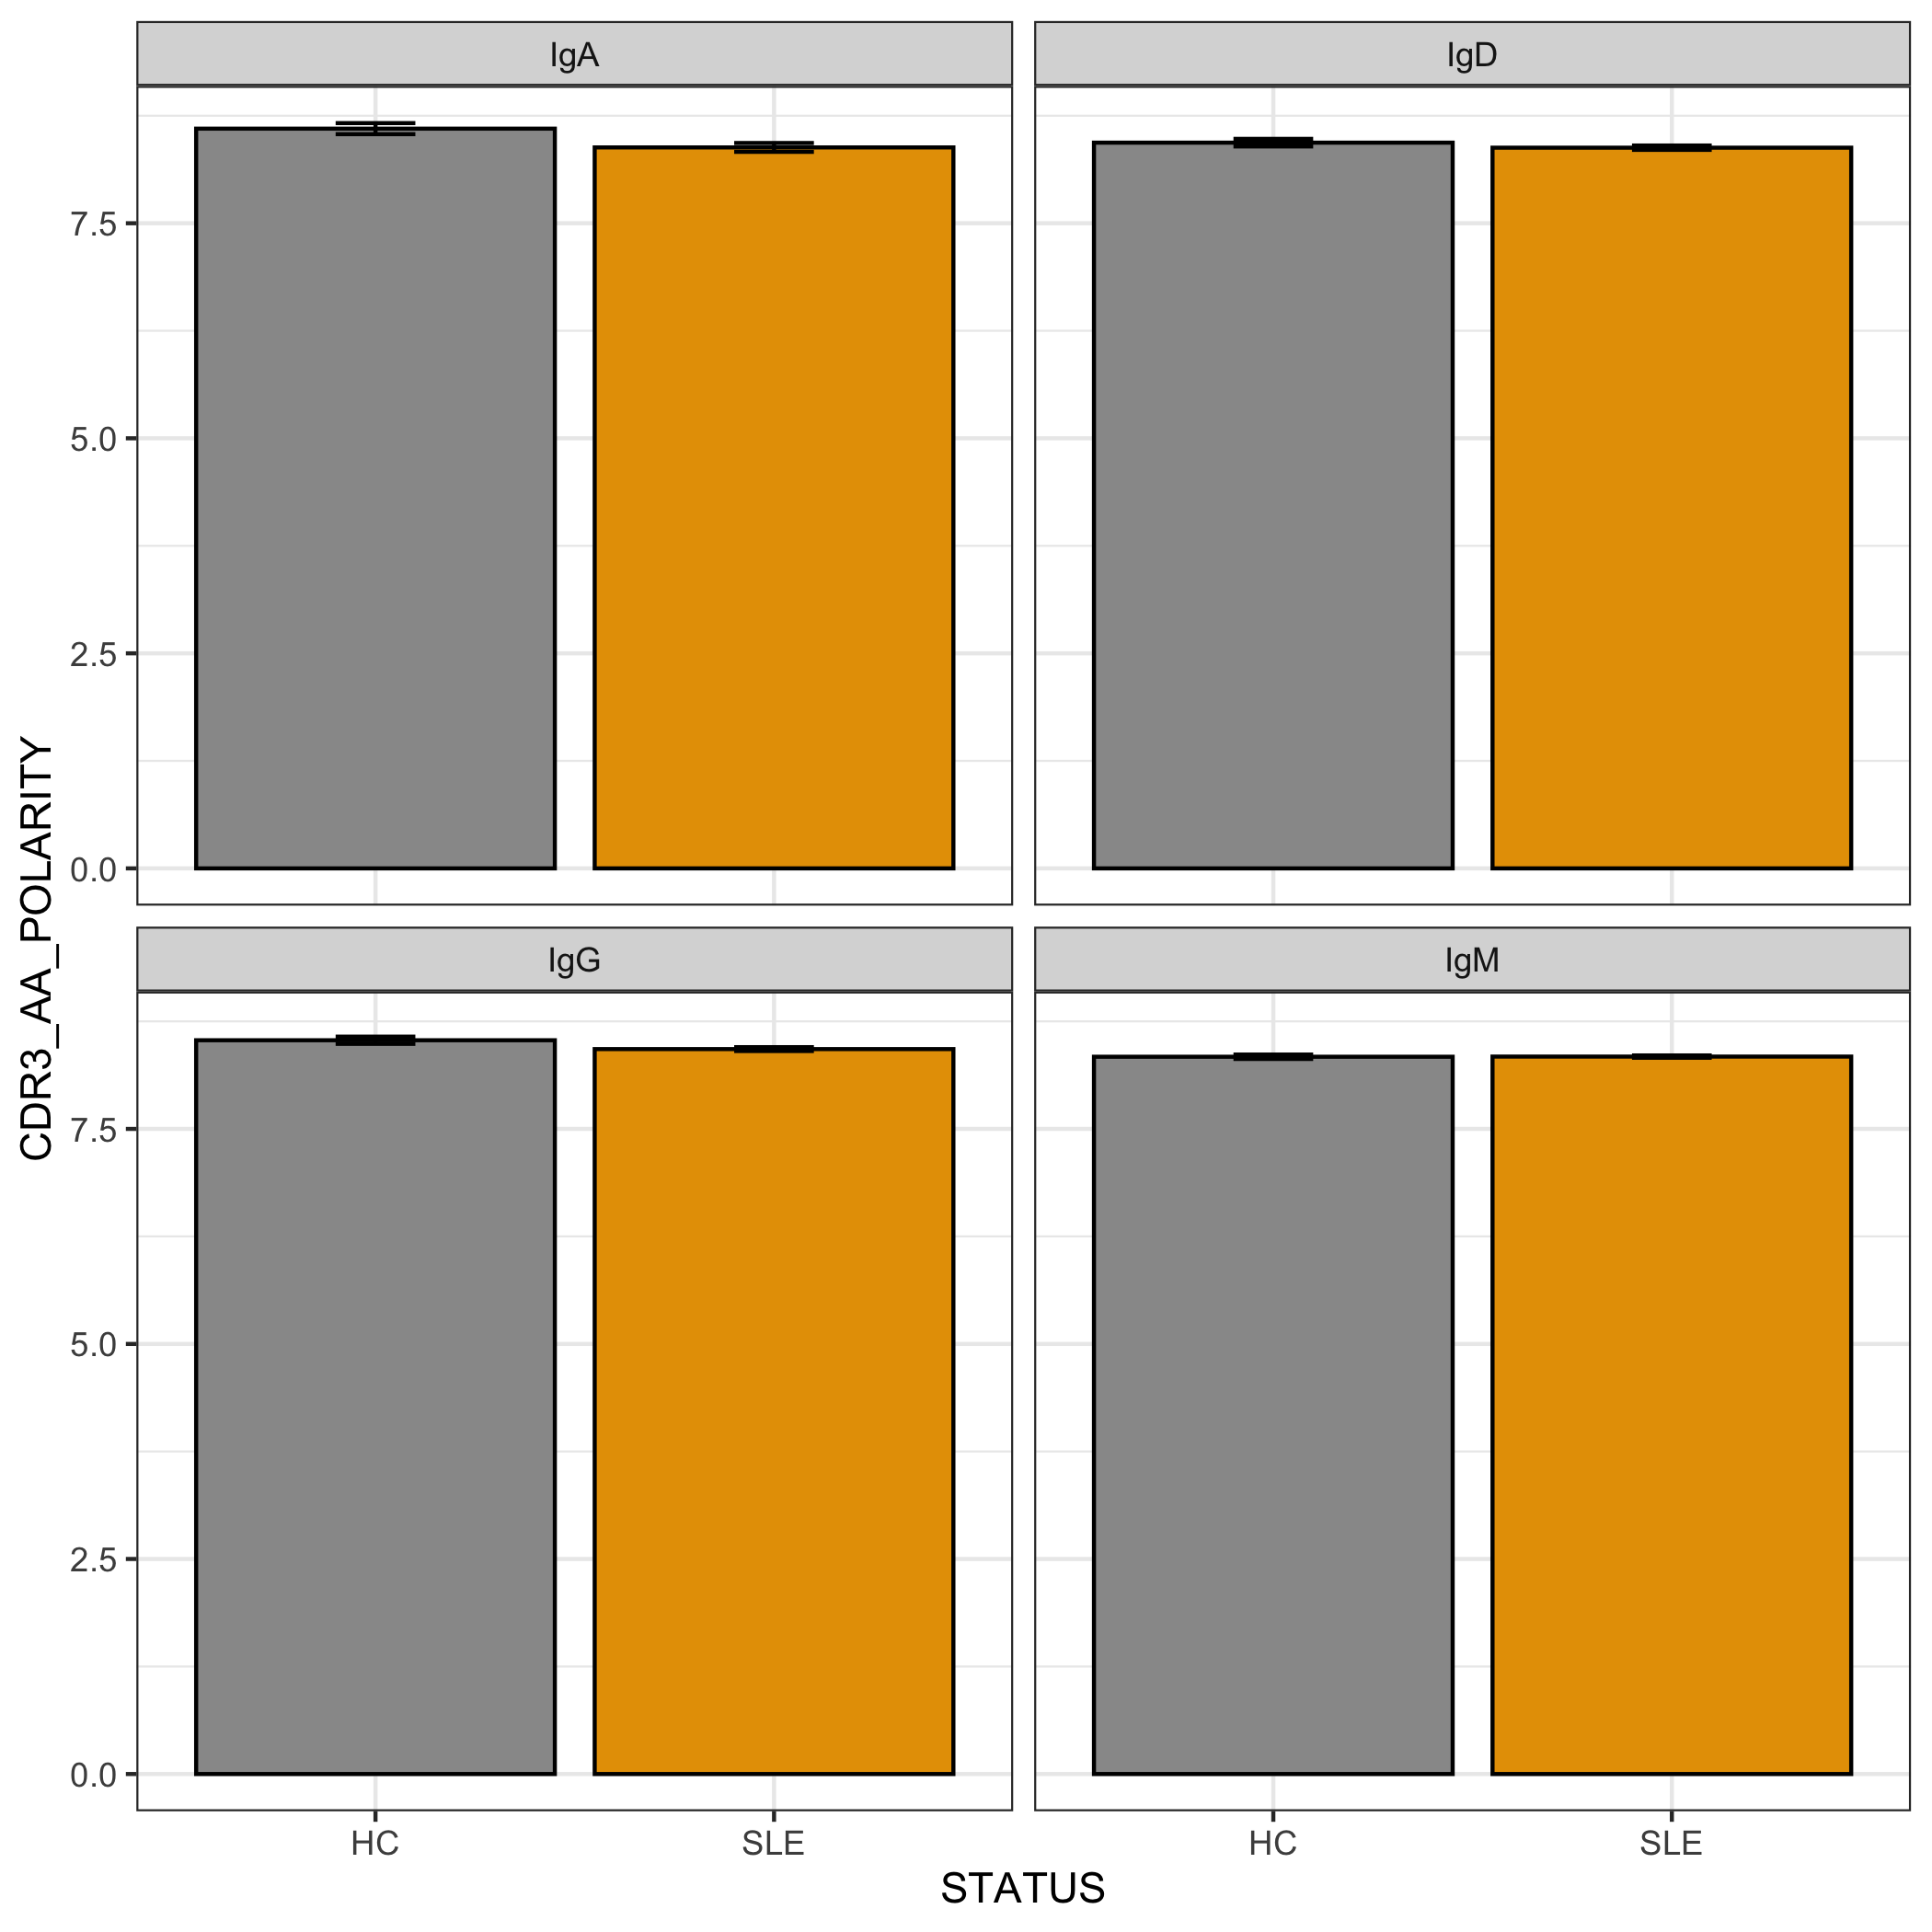
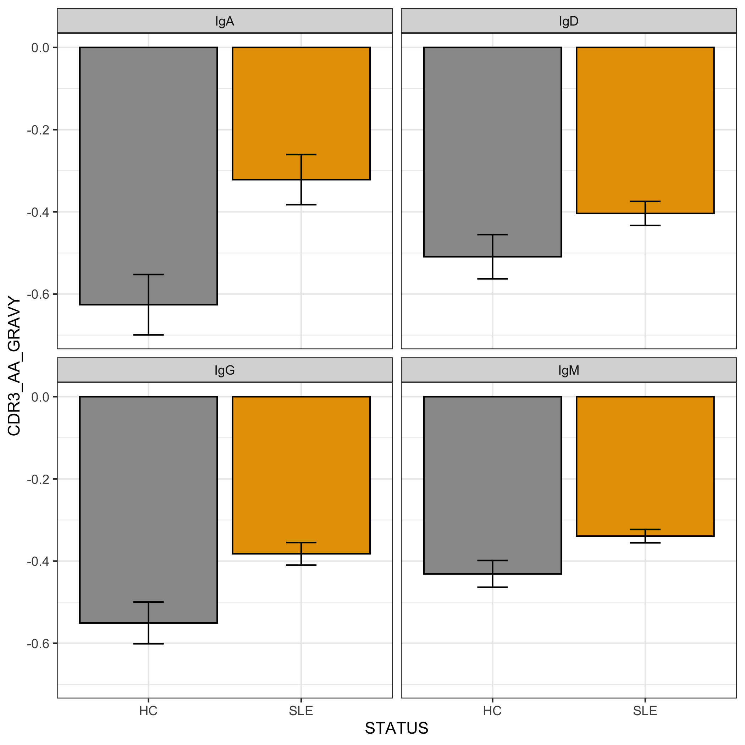
Physicochemical properties analysis

